Slide 1
Requirement Engineering

Slide 2
Requirements Engineering Process
Helps software engineer to better understand the problem
Participants involved
Software Engineers
Managers
Customer
Users
Requirements focus on the customer needs, not on the solution or implementation
Designate WHAT behavior, without saying HOW that behavior will be realized
Notes:
Requirements focus on the customer needs, not on the solution or implementation

Slide 3
Requirements Engineering
Seven tasks:
Inception
Elicitation
Elaboration
Negotiation
Specification
Validation
Management

Slide 4
Inception (Beginning)
During inception, the requirements ask a set of questions to establish
Basic understanding of the problem
Nature of the solution that is desired
Requirements Engineers need to identify the stakeholders, recognize multiple viewpoints, work towards collaboration and initiate the communication.

Slide 5
Elicitation (Extraction)
Ask questions about objectives, targets etc
Eliciting requirements is difficult because of
Problems of scope → identify the boundaries of the system
Problems of understanding → domain, computing environment
Problems of Volatility → requirements may change over time
Elicitation may be accomplished through two activities
Collaborative Requirements Gathering
Quality Function Deployment

Slide 6
Elaboration (explanation)
Takes the information obtained during inception and elicitation
Focuses on developing a refined model of software functions, features and constraints
This is an analyzing phase
It defines the functional informational and behavioral constraints of the problem domain.

Slide 7
Negotiation (Cooperation)
Software Engineer reconciles the conflicts between what the customer wants and what can be achieved.
Requirements are ranked by the customer, users and other stakeholders
Risks associated with each requirement is identified

Slide 8
Specifications
Final work product produced by the requirements engineer
Form of SRS
Serves as a foundation of the project
It formalizes the functional and behavioral requirements of the software in both the graphical and textual format.
Notes:
Software requirements specification

Slide 9
Validation
Specification is examined to ensure that all the software requirements have been stated unambiguously
Errors have been detected and corrected.

Slide 10
Requirements Management
Project team performs a set of activities to identify, control and track requirements and changes to the requirements at any time as the project proceeds
Each requirement is assigned a unique identifier
Places the requirements into one or traceability tables
Tables may be stored in a database that relate features, sources, dependencies subsystems and interfaces to the requirements.

Slide 11
Types of Requirements
Customer Requirements
Define the expectations in terms of Mission Objectives, Environment, Constraints and Measures of Effectiveness and Suitability (MOE/MOS)
Functional Requirements
Explain what has to be done
Identify the necessary action or activity and task
Used as the top level functions for functional analysis.

Slide 12
Types of Requirements (continued)
Non functional Requirements
Specify criteria that can be used to judge the operation of a system rather than behavior.
Also known as Quality requirements
Usability goals
Concerned with human computer interaction
Reliability goals
Performance goals
Example: system must respond in 1 second
Supportability goals
Concerned with compatibility and portability of software from one platform to another.
Security goals
Authentication, confidentiality etc.
Non functional requirements may or may not be verifiable.

Slide 13
Requirement Engineering
Feasibility Study
Find out the current user needs
Budget
Requirement Analysis
What the stakeholders require from the system
Requirements Definition
Define the requirements in a form understandable to the customer
Requirements Specification
Define the requirements in detail

Slide 14
Requirements Document
Official Statement
Include both a definition and specification
Specify external system behavior
Specify implementation constraints
Easy to change
Problems
Stakeholders don’t know what they really want
Stakeholders express requirements in their own terms
Requirements change during the analysis process

Slide 15
Groundwork Establishment
Identify Stakeholders
Recognize viewpoints
Establishing collaboration among stakeholders through conversations and questionnaires among the stakeholders.

Slide 16
Multiple Viewpoint recognition
Marketing Group is interested in functions and features (easy to sell)
Support Engineers may focus on maintainability of the software
Business Managers are interested in a feature that will be ready to meet defined market windows.

Slide 17
Collaboration
Each stakeholder has a different opinion about the set of requirements
Requirement engineer must identify areas of commonality.
Identify areas of inconsistency
Reduce dependencies among engineers.

Slide 18
Elicitation
Discovering the requirements for the system
Identify the requirements by communicating with the customers, system users and others
Requirements sources
Domain knowledge
Stakeholders
Elicitation techniques
Interviews
Scenarios
Prototypes
Observation

Slide 19
Use Cases
Use cases describe the interactions between a user and a system
Focusing on What the system DOES for the user
Describe the totality of the system and behavior of the system
Includes
Actors list
Use case packages
Use case diagrams
Use case text
Use case views

Slide 20
Steps for developing use case diagram
Use abstract idea
Define use case actors
Define use case actor goals
Identify reuse opportunity for use case
Create use case index
Identify the key components
Name and briefly describe the use case
Create use case basic view
Create use case alternative view
Produce the use case document
Generate a use case model diagram

Slide 21
Use Case Diagram
Components
A large box: system boundary
Stick figures outside the box: actors, both human and systems
Each oval inside the box: a use case that represents some major required functionality and its variant
A line between an actor and use case: the actor participates in the use case
Use cases do not model all the tasks, instead they are used to specify user views of essential system behavior

Slide 22
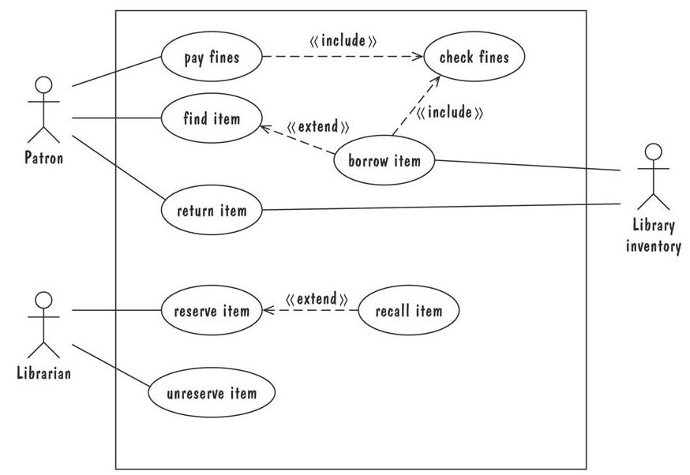
Use Case Diagram
Library use cases including borrowing a book, returning a borrowed book, and paying a library fine

Slide 23
Writing Usecases
Mark Attendance Usecase

Slide 24
Requirements
Functional Requirements specify features (functionalities) the software must have/perform
The system must produce daily reports summarizing all transactions for a 24-hour period.
Non Functional Requirements specify other properties that the system must have
The system must be available at least 96% of the time.

Slide 25
Requirements vs Design Goals
Requirements are concrete specifications that MUST be met for a product to be acceptable
The system must be able to process at least 1000 transactions per hour
Design goals are properties that it is desirable to optimize without specific limits.
The system should process as many transactions per hour as possible.

Slide 26
Functional Requirements
One of the easiest way to determine functional requirements is to look at the actions the system must take during a use case:
Use case step: “The system presents a form for the user to enter personal data”
Obvious requirement: “The system must present a form for the user to enter personal data
Better requirement: “The system must provide a means for user to submit personal data.

Slide 27
Requirements describe the system, not the user
Wrong: The user must enter their data
Right: The system must provide a means for the user to enter their data
Wrong: The user must have 12 years of education
Right: The system must be designed for users having 12 years of education

Slide 28
Well written requirements include three major components
Description: States the requirement in a brief, easy to understand sentence, often beginning with “The system must …”
Rationale: Describes why the requirement is necessary, often clarifying description
Fit Criterion: Further clarifies requirement, and provides a means of determining whether or not it has been met.

Slide 29
Non Functional Requirements
Less obvious: therefore harder to develop
These include
Usability
Reliability
Performance
Supportability
Others (Legal, operations, implementation etc)

Slide 30
Usability
Specifies the ease with which the user uses the product correctly, and the difficulty with which the use it incorrectly
The system must be easy for new users to use. Fit Criteria: “90% of the users should be able to create a new document within 10 minutes without

Slide 31
Reliability (Dependability)
May have different metrics
Percentage availability (uptime)
Maximum duration of a service outage
Percentage of time “yielding” correct behavior
No loss of data
Some include security in this category too

Slide 32
Performance
May include
Speed, operations per time
Lag allowed: time between a command and execution
Capacity (number of records etc)
Space required

Slide 33
Quality Requirements
High Quality requirements must be
Traceable: maintain connections between requirements and sources, code and tests etc.
Verifiable: Any requirement that cannot be verified or tested is useless. Quality assurance of the final product begins during requirements development. In particular, acceptance tests are often derived as part of the requirements development process
Clear and unambiguous
Realistic:
Correct
Notes:
Realistic: specifying unattainable requirements cannot be met
Correct: not containing errors.

